Slide 1
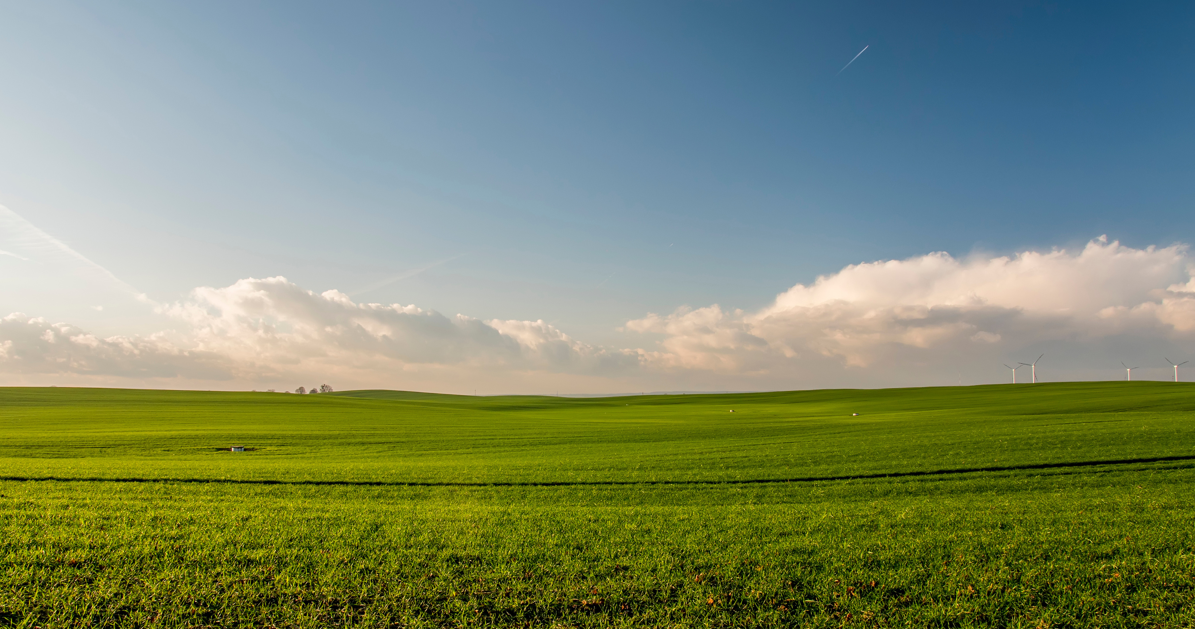


AGRIAN
presented by:
ORBIT-X

Slide 2



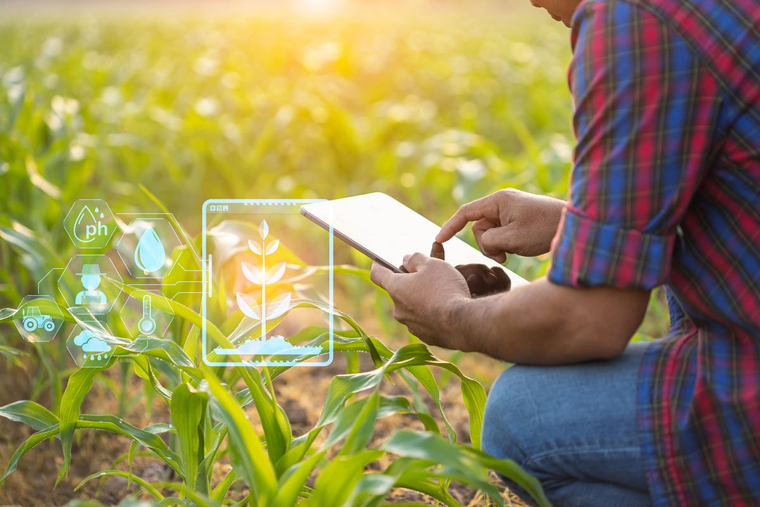
LEVERGING EARTH OBSERVATION DATA FOR INFORMED AGRICULTURE DECISION MAKING
Leveraging Earth Observation (EO) data for agricultural decision-making is a game-changer for modern farming
EO data, collected from satellites and other remote sensing technologies, provides valuable insights into various environmental factors like soil moisture, crop health, weather patterns, and more
. By analyzing this data, farmers can make more informed decisions about irrigation, planting schedules, pest control, and resource allocation

Slide 3
Our Products
Harvesting schedule
Pest infection
Outbreak of disease

Slide 4
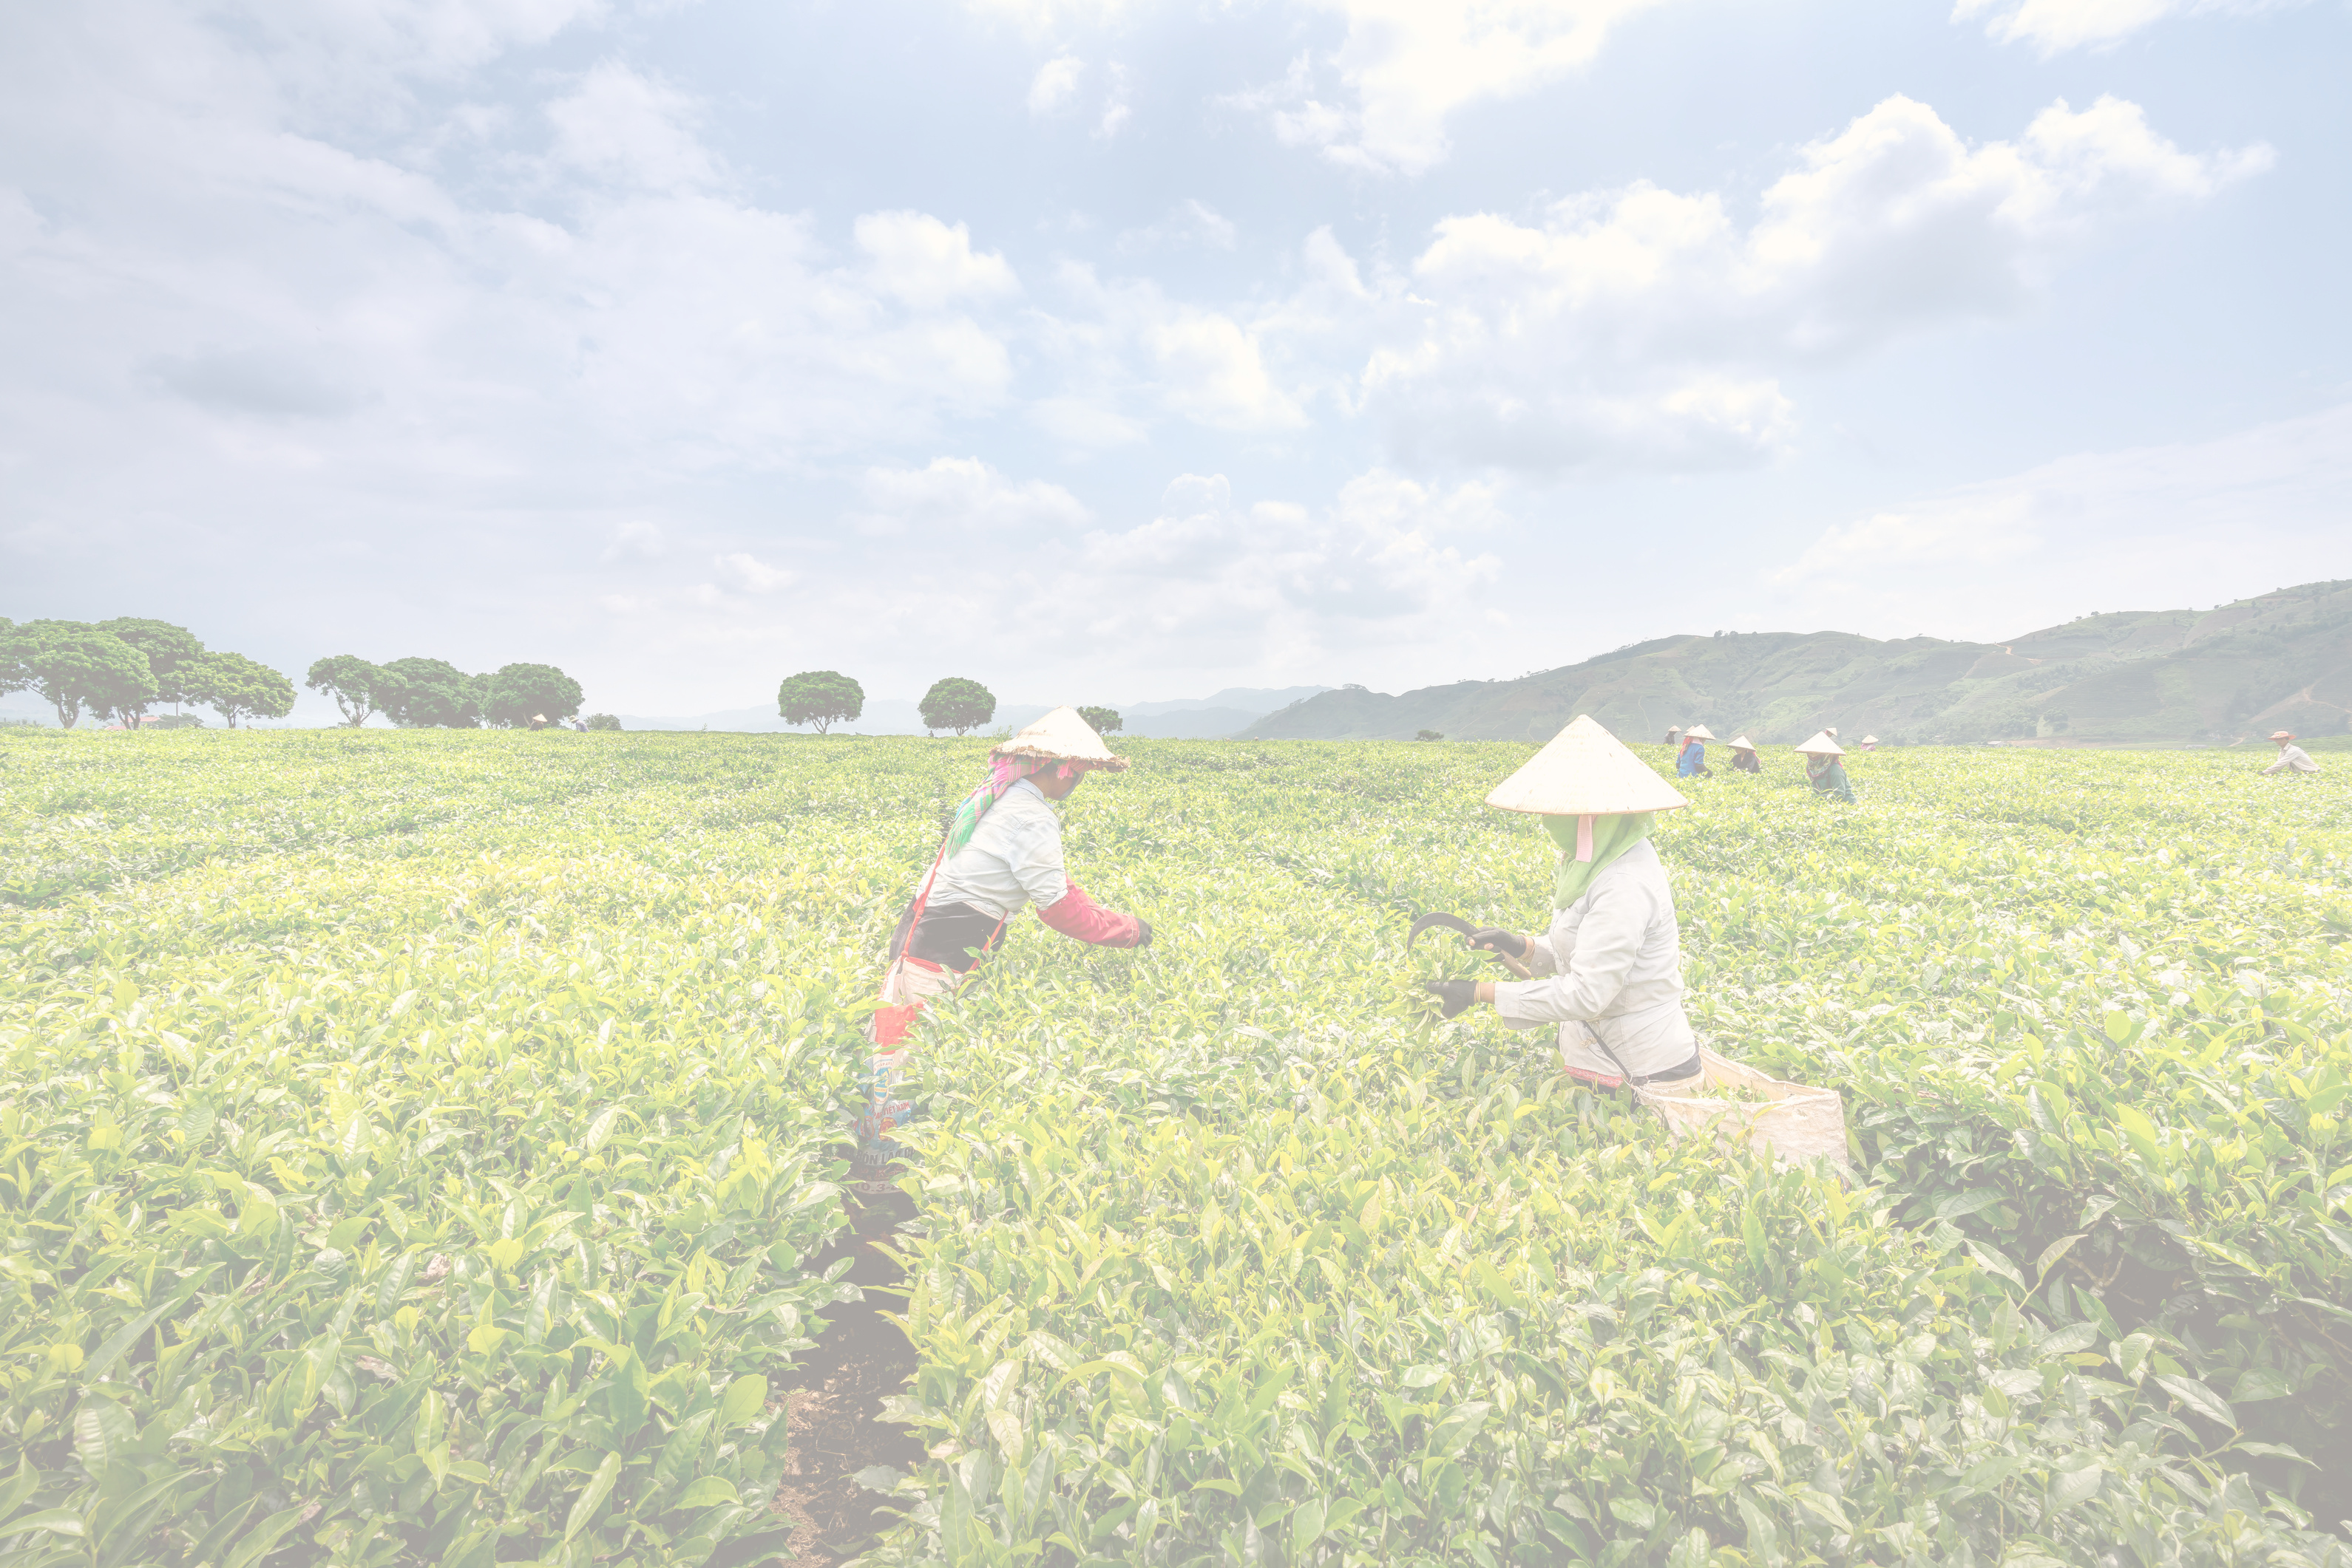
Harvesting schedule
We inserted a calendar to schedule the harvest season and remained it to harvest the period of time.
It will connect to weather predictions, so it will be an analysis of crops to
It will give an idea to analyze the crop that is suitable to the weather and to make as to gain profit.

Slide 5
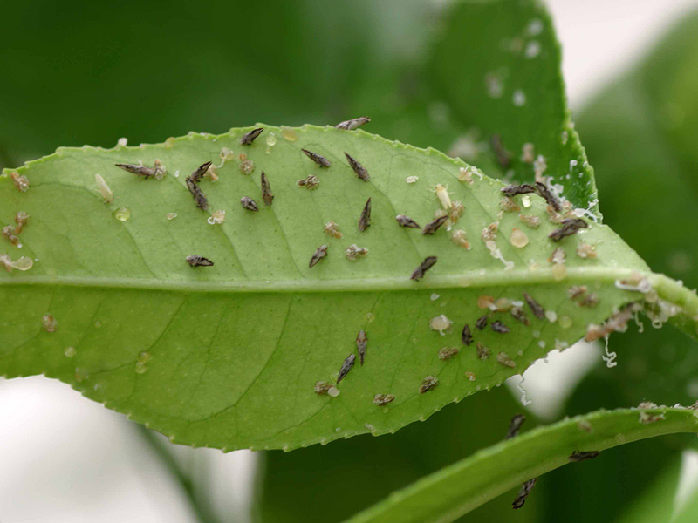

PEST INFECTIONS
Pest infections in agriculture can be quite a headache for farmers! Pests like insects, mites, nematodes, and gastropod molluscs can cause significant damage to crops, both directly and indirectly by transmitting fungal, bacterial, or viral infections
Managing these pests effectively often involves integrated pest management (IPM) strategies, which can include biological methods (like using natural predators or entomopathogenic microorganisms), cultural methods (such as crop rotation and sanitation), and chemical methods (pesticides)

Slide 6
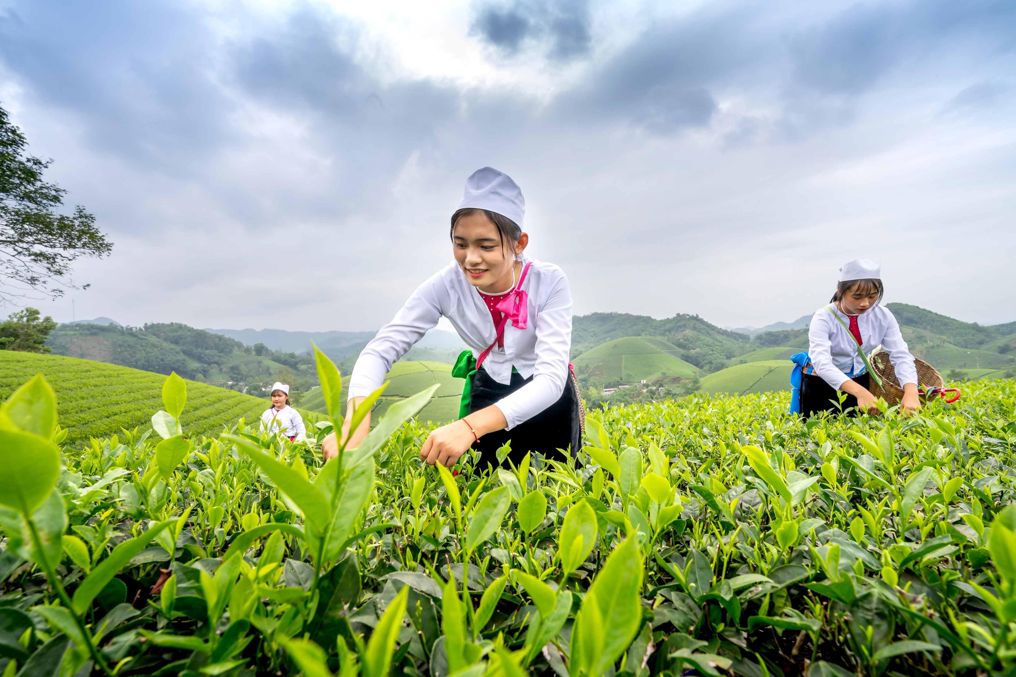

Outbreak of disease
Leveraging Earth Observation (EO) data can be incredibly useful in managing disease outbreaks in agriculture. By using EO data, farmers and researchers can monitor crop health and detect early signs of disease outbreaks. This allows for timely interventions, such as targeted pesticide applications or other control measures, to prevent the spread of diseases.
With real-time data access, apps can alert farmers about potential issues, provide actionable insights, and even recommend tailored solutions based on specific EO data analyses. This approach not only promotes healthier crops and improved yields but also supports sustainable farming practices.
www.reallygreatsite.com

Slide 7


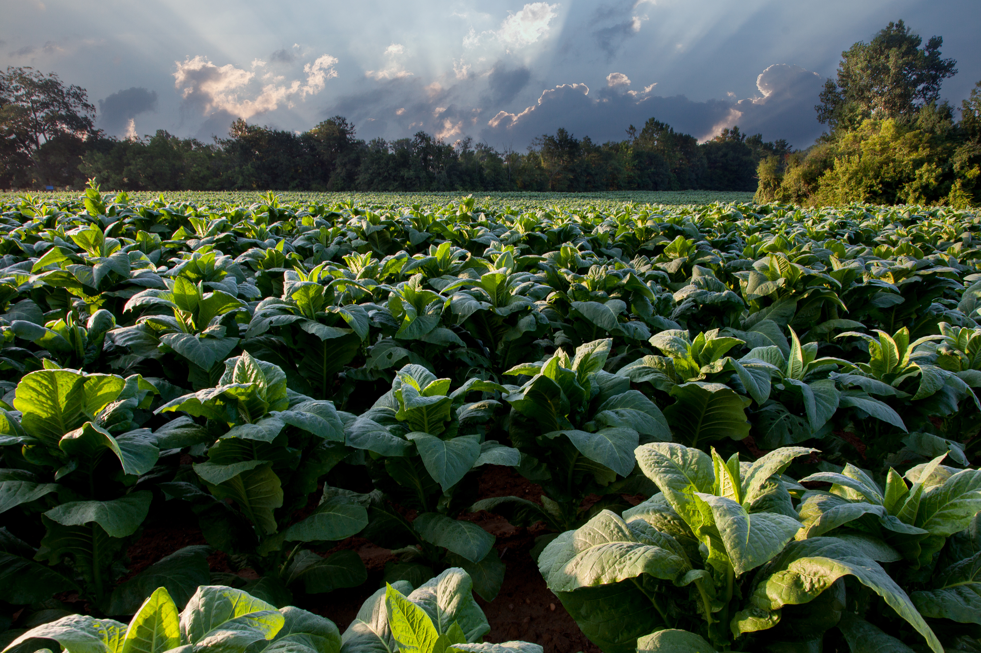

CONCLUTION
In conclusion, leveraging Earth Observation (EO) data for informed agricultural decision-making is a powerful tool in modern farming. By providing real-time insights into crop health, soil conditions, weather patterns, and potential disease outbreaks, EO data enables farmers to make precise and timely interventions. This approach not only enhances crop yields and reduces losses but also promotes sustainable farming practices.
Integrating EO data into app development further amplifies its benefits, offering farmers a user-friendly and accessible way to monitor their fields and respond proactively to challenges. Ultimately, the adoption of EO data in agriculture represents a significant step toward ensuring global food security and resilience in the face of changing environmental conditions.

Slide 8
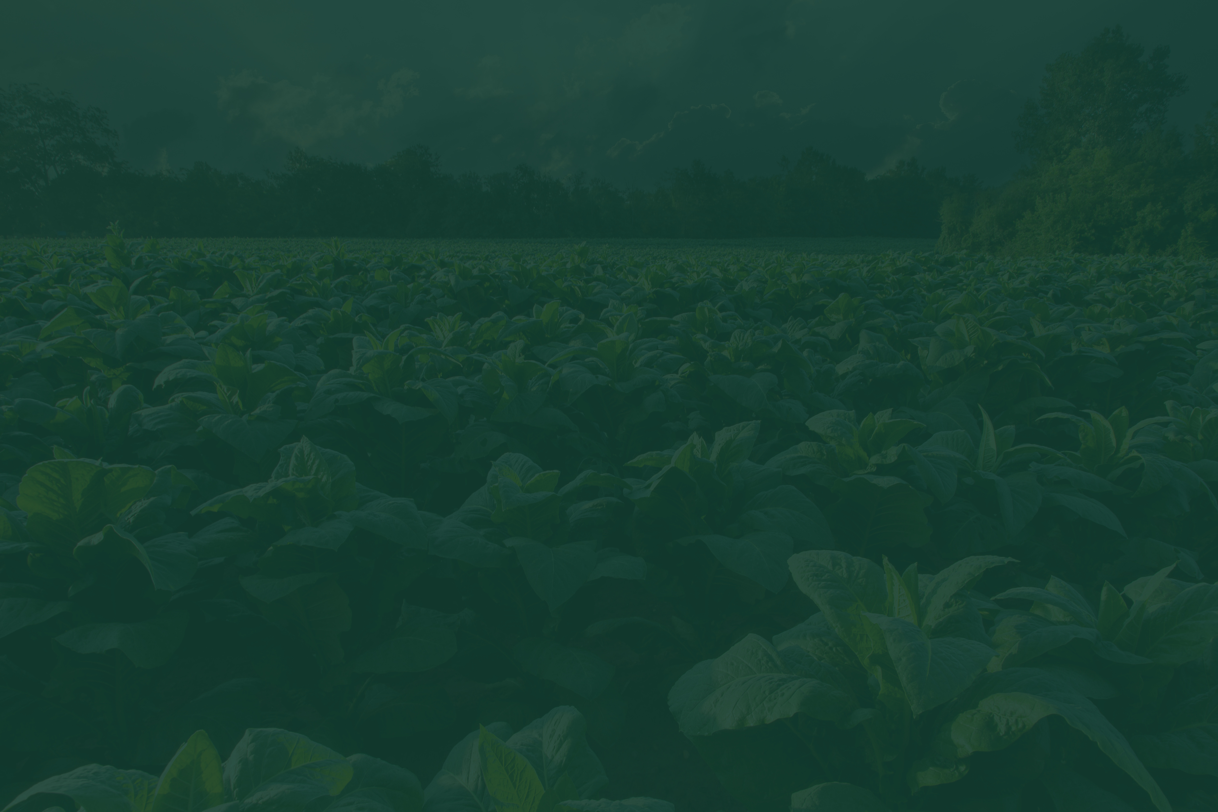
Thank You!

